Slide 1
Rockbuster Stealth Data Analysis Project for Company Strategy in 2020
Lee Sai Chee
10 April 2023

Slide 2
Setting the Scene
Background
Rockbuster Stealth LLC is a movie rental company that used to have stores around the world.
Challenge
The Rockbuster Stealth management team is planning to use its existing movie licenses to launch an online video rental service.
This is to stay competitive against other streaming service providers such as Netflix and Amazon Prime.

Slide 3
Project Objective
To answer the business questions from the Rockbuster Stealth Management Board for the company strategy in 2020.
Which movies contributed the most/least to revenue gain?
What was the average rental duration for all movies?
Which countries are Rockbuster customers based in?
Where are customers with a high lifetime value based?
Do revenue vary between geographic regions?

Slide 4
Question 1: Which movies contributed the most/least to revenue gain?

Slide 5
Average Revenue per Movie across Genres
Sci-fi and comedy genres have the highest average revenue per movie.

Slide 6
Question 2: What was the average rental duration for all movies?

Slide 7
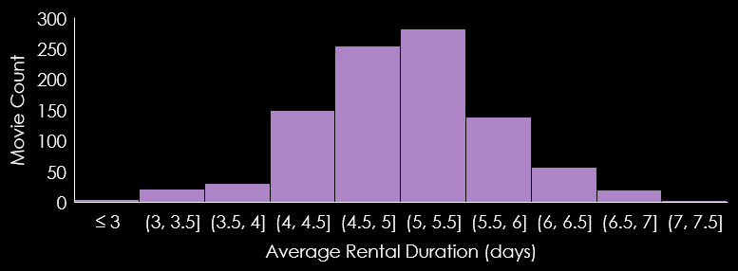
Average Rental Duration of Movies
Majority of the movies have an average rental duration of 4.5 to 5.5 days.
However, a longer average rental duration could affect the availability of a movie.
So, is our movie inventory adequate for the demand?
Min Average Rental Duration: approx. 2.0 days
Max Average Rental Duration: approx. 7.5 days

Slide 8
Movie Inventory vs Demand
Our movie inventory is adequate for the demand.
How to know this?
The unused rental capacity is calculated for each movie.
Basically, it is the result of the maximum rental capacity deducting the number of actual rentals of a movie.
If the unused rental capacity of a movie is close to zero, that means it is reaching its rental capacity limit. It’s time to increase its inventory for the demand.

Slide 9

Unused Rental Capacity of Movies
The unused rental capacity of movies ranges from 63 times to 488 times.
No movie has an unused rental capacity close to zero, which means they are not reaching their rental capacities yet.
Thus, our movie inventory is adequate for the demand. No action is needed.
Min Unused Rental Capacity: 63 times
Max Unused Rental Capacity: 488 times

Slide 10
Question 3: Which countries are Rockbuster customers based in?

Slide 11
Countries with More Than 10 Customers
India and China have the largest customer base.
U.S., Japan, Mexico, Brazil and Russian Federation have relatively high customer counts.

Slide 12
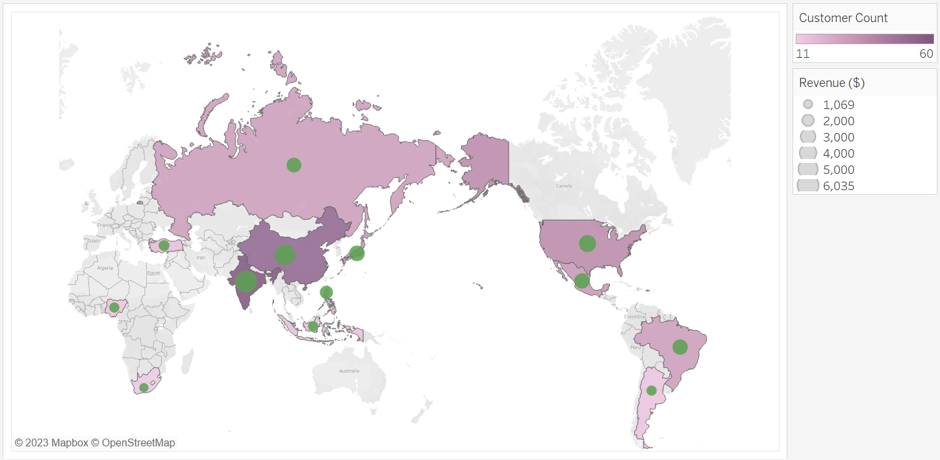
Countries with More Than 10 Customers and Their Revenues
Russian Federation
Japan
United States
China
Mexico
Brazil
India

Slide 13
Relationship between Customer Count and Revenue of A Country
The correlation between these two variables is positive and strong.
The higher the customer count, the higher the revenue for a country.

Slide 14
Question 4: Where are customers with a high lifetime value based?

Slide 15
10 Countries with The Highest Average Spend per Customer
S/N | Country | Customer Count | Average Spend per Customer ($)
1 | Réunion | 1 | 212
2 | Holy See (Vatican City State) | 1 | 147
3 | Nauru | 1 | 144
4 | Sweden | 1 | 140
5 | Belarus | 2 | 136
6 | Thailand | 3 | 134
7 | Czech Republic | 1 | 133
8 | Moldova | 1 | 128
9 | Turkmenistan | 1 | 127
10 | Latvia | 2 | 125
The customers of these countries spent a lot on average.
However, these countries have a very low customer count.

Slide 16
Question 5: Do revenues vary between geographic regions?

Slide 17
Revenue in Different Regions
Asia is the largest market based on its revenue gain.

Slide 18
Conclusions and Recommendations

Slide 19
Conclusions
Sci-fi and comedy genres generate the most revenue per movie.
Based on the unused rental capacity for each movie, the inventory of each movie is sufficient.
India and China have the highest number of customers, followed by the United States, Japan, Mexico, Brazil, and the Russian Federation. Countries with more customers could generate higher revenue.
The 10 countries with the highest average spend per customer are Réunion, Holy See (Vatican City State), Nauru, Sweden, Belarus, Thailand, Czech Republic, Moldova, Turkmenistan, and Latvia. However, they have a very low customer count.
Asia is the largest market based on revenue gained, followed by Europe, North America, South America, Africa, and Oceania.

Slide 20
1st Recommendation
WHAT
More variety of sci-fi and comedy movies should be purchased and made available.
WHY
The movies from these genres can generate higher revenue on average.
HOW
- Always get the updated list of the latest sci-fi and comedy movies from movie license providers.
- Explore the sci-fi and comedy movies produced in different countries

Slide 21
2nd Recommendation
WHAT
More marketing budget should be distributed to Asia countries, especially India and China.
WHY
Asia is the largest market in terms of revenue gain, and India and China have the largest customer base.
HOW
- Introduce more attractive packages or subscription plans to preserve the customer base
- Expand the variety of subtitle languages to favour the Asia customers

Slide 22
3rd Recommendation
WHAT
Explore the potential market in Réunion, Holy See (Vatican City State), Nauru, Sweden, Belarus, Thailand, Czech Republic, Moldova, Turkmenistan, and Latvia.
WHY
The customers there spent a lot on average, but these countries have a very low customer count.
HOW
- Introduce a referral rewarding program
- Offer a price discount on the first rental for new users

Slide 23
Thank You
For any questions, feel free to contact me at saicheelee1995@hotmail.com
LINK TO visualization: Visualizations for Rockbuster project

